Slide 1
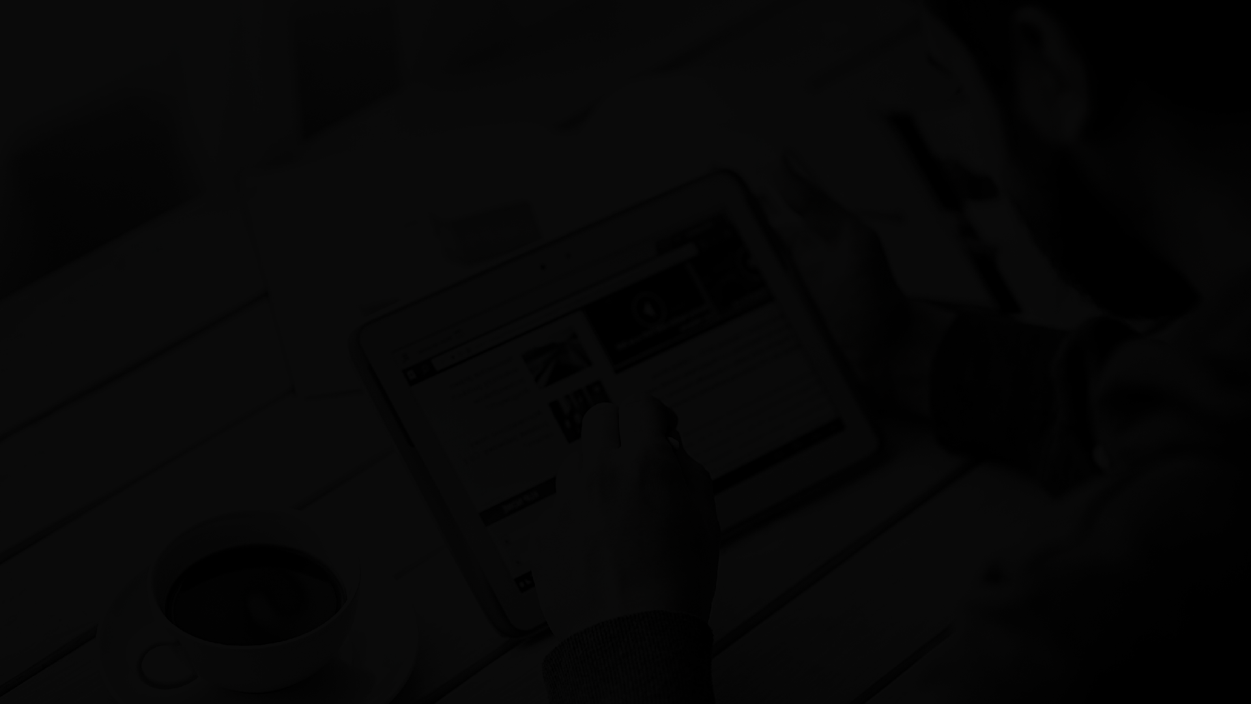
Vaccine Tracker
HelloWorld!

Slide 2
12/4
1st Sprint Start
Project Timeline
2/5
1st Sprint Completion
10/5
2nd Sprint Start
30/5
2nd Sprint Completion

Slide 3
BigChainDB
We wanted to separate the actions between MongoDB and BigChainDB.
Sprint Goals
Ux Design
With the end of the first sprint our goal was functionality, in this sprint we aimed for the better appearance as well.

Slide 4
Technologies
MERN...The bread and butter of the app.
Front-end
React
Redux Bootstrap 4
Reactstrap
Back-end
Node.js Express.js
Database
MongoDB BigChainDB

Slide 5
Create asset With the creation of a new vaccination , a patient is created who is then stored in mongoDB a copy of which is also saved in BigChainDB
BigChainDB
Update asset
With each update a history of patient updates is created
Delete asset
The asset is transferred with random keys which makes it then untransferable

Slide 6
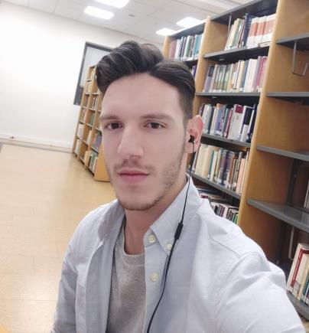
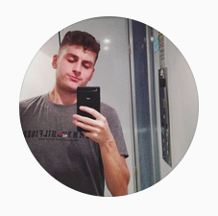
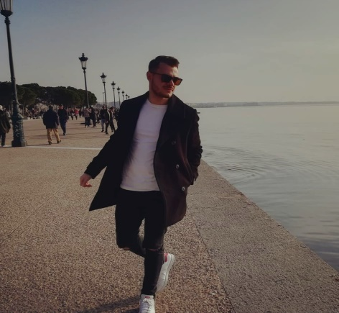
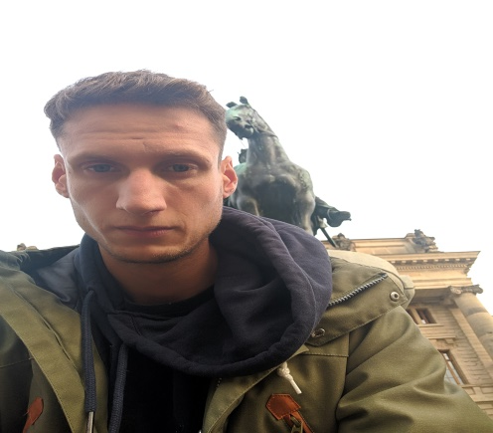
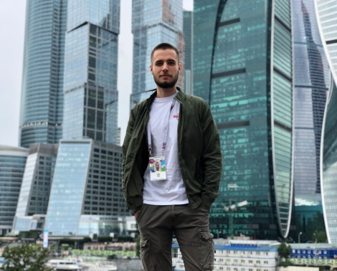
Meet the Team
Prassas Thanos
Dimou Giorgos Konstantinos
Mesimeris Michael
Kessidis Nikos
Lazogiannis Sotiris

Slide 7
Thank you for your time!

